Slide 1
Peer To Peer Video Chat
Deepak T S
Gaomeizhu Qu
Sijia Zhang
Nov.28th 2016
https://github.com/vsemp/ECE601Project
https://trello.com/b/5TKkUxnn/welcome-board
Notes:
1
Good evening, we are the video chat team and now is our sprint 3 presentation. In sprint 2, we built database for our project and connected it to the login program. Also we have a program for video chat.

Slide 2
Product Highlights
Product statement

Slide 3
Demonstration
Please make sure you prepare a video in case the demo may not work properly

Slide 4
Test results
List test cases, success and failure.
Characterize defects by priority and severity
Recommended: Monkey test, farm test, etc.

Slide 5
Lessons Learned
Top three things that worked well
Top three things that you have learned
Top three things that did not go well
One thing you as a team will do differently in the future
Any future plans for your project

Slide 6
Slides to be included but not presented
Use cases developed
System architecture
Technologies selected

Slide 7
Thank You

Slide 8
Summary of progress What we have accomplished:
*
1. Be able to change the size and position of the local and remote video views.
2. Add dual camera button and split into two windows.
3. Two separate programs : login(database) and video chat.
What we could not accomplish right now:
1. Enable both camera.
2. Add inviting friends feature into the app.
3. Combine the login program with our app.
8
Notes:
In sprint 2, we built database for our project and connected it to the login program. Also we demoed a program for video chat.
In the past few weeks, we have been working on add dual camera feature to our application.
Although it’s more complicated than we thought, we still have some accomplishment.
First, we have figured out how to change the location and size of the remote and local video views.
Second, we add a button to split the original windows into 2 parts which are supposed to show both front and back camera view.
Compared to plan of sprint2, we still have some tasks to accomplish. First, the back camera cannot be enabled while the front one is working. Second, we haven’t added the inviting friends feature into the app. Since the time is limited and we don’t think we have enough time to do it. Third,we have not finished combine the login with our app. But we have been almost done.

Slide 9
Dual camera Diagram:
*
A(front)
A(front)
A
A clicks the button
B
B
A (back)
B clicks the button
B(front)
B(front)
A and B both click the button
A(front)
A
A(back)
B(back)
B(back)
9
Notes:
now i am going to introduce the diagram of our dual camera function. Suppose A and B are using video chat app.
This is the view of person B. in our app, the dual camera button is on the right, which is marked black.
When A clicks the button, it sends a signal to B to change B’s layout. the original window of A will be split into 2 parts. One shows the capture of front camera, and the other is the capture of back camera.
When B himself click the button, the windows of B will be changed into 2 parts.
When A and B both click the button, the layout will be like this.
Until now, we have finished the first step which is to add a dual button and split the windows into two parts when we click the button.

Slide 10
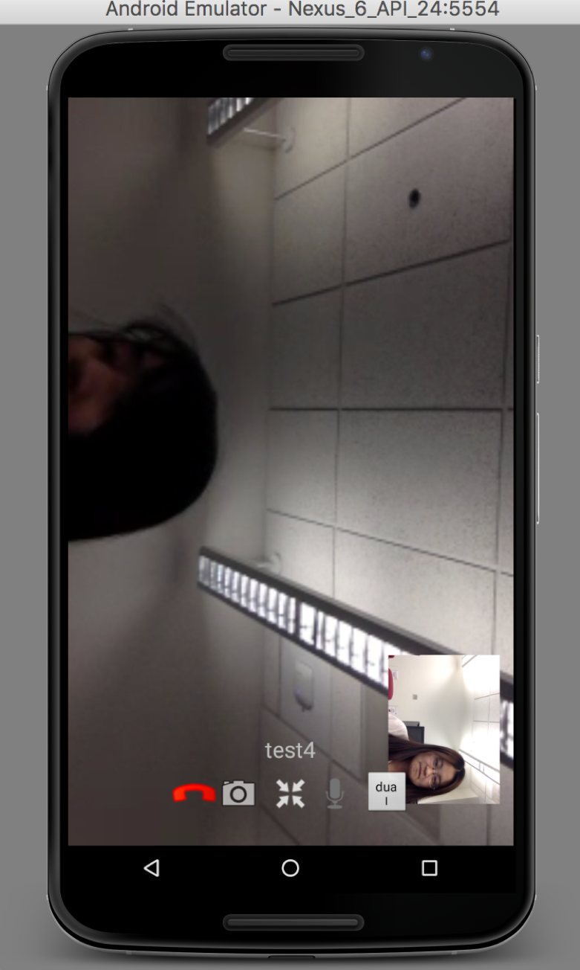
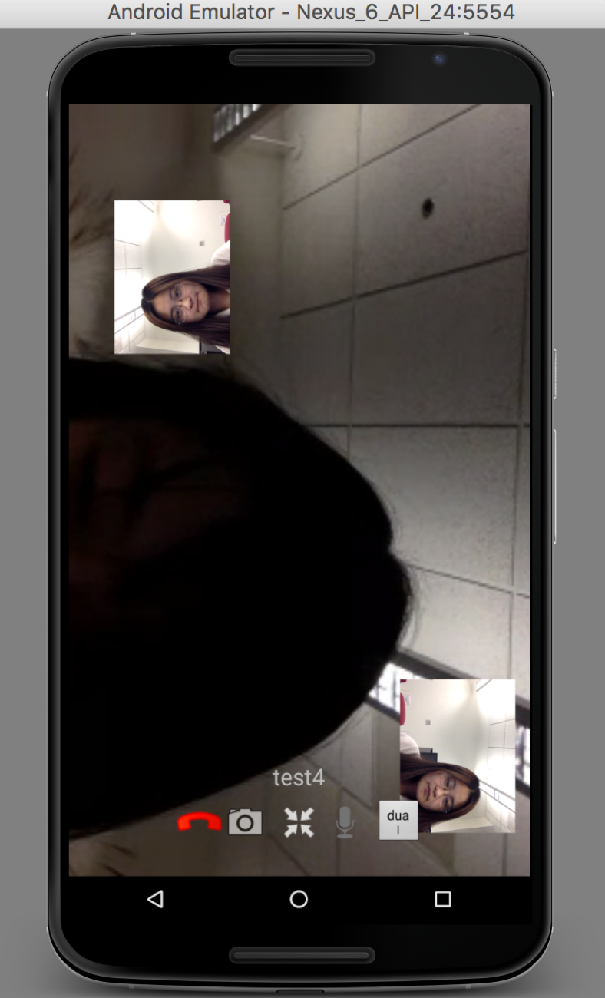
DEMO
*
B
A
A
B
B
Click!
10
Notes:
Now it’s the demo part.
Until now, we have finished the first step which is to add a dual button and split the windows into two parts when we click the button. We will work on how to get the capture of both cameras at the same time and send two media stream through webRTC.
Before clicking button, the screen is like the first picture. After clicking button, there will be one more window appears on the screen, which is supposed to show the back camera video capture. But now, it can’t work perfectly. We will work on it later. Now I’m going to show the details.

Slide 11
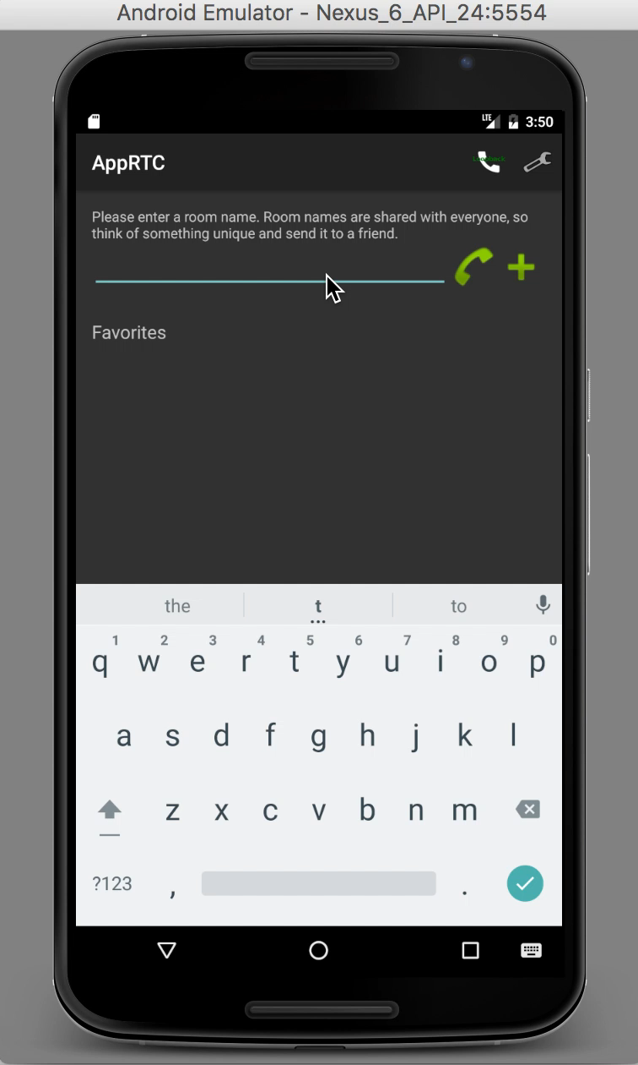
DEMO
*
11
Notes:
Now it’s the demo part.
Until now, we have finished the first step which is to add a dual button and split the windows into two parts when we click the button. We will work on how to get the capture of both cameras at the same time and send two media stream through webRTC.
Before clicking button, the screen is like the first picture. After clicking button, there will be one more window appears on the screen, which is supposed to show the back camera video capture. But now, it can’t work perfectly. We will work on it later. Now I’m going to show the details.

Slide 12
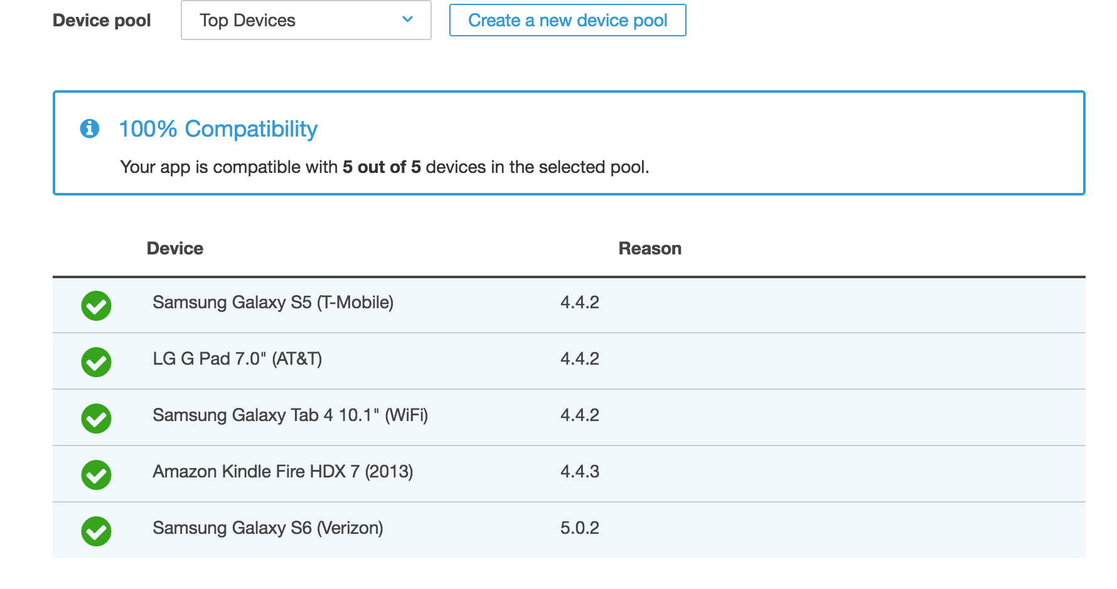
Testing conducted
*
We tested the video chat program through AWS device farm:
12
Notes:
The next part is about testing conducted. we tested the video chat program through AWS device farm. It past all 5 devices and it shows perfectly compatibility.

Slide 13
Challenge:
WebRTC supports dual camera?
Video stream
device
SDP Package
Peer connection
device
Audio stream
internet
Notes:
There are still some challenges in our project. The first one is about the WEBRTC tech, In webRTC tech, it put video and audio stream into one SDP package and send it to a function named peerconnection. in this function, it send the package to another device.
the second device will pick up useful information from the package to build a p2p channel and make communication works.
But now we want 2 camera work together. So we need to put 2 video stream into one package which might not be supported by webRTC.

Slide 14
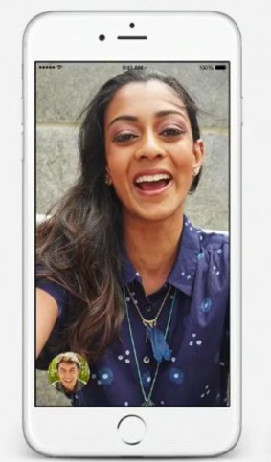


Sprint 4 Plan
*
Add “both cameras” feature into the app.
Combine login with our app.
Download and test on an android phone.
14
Notes:
Next is our plan for sprint 4. We will continue working on the dual camera feature and hope to have a complete application.

Slide 15
THANK YOU
*
15

